Slide 1

Natural Language Processing
Recitation Class

Slide 2
Recap
Language Model: A system that predicts the next word
Recurrent Neural Network: A family of neural networks that:
Take sequential input of any length
Apply the same weights on each step.
Can optionally produce output on each step
Problems: Vanishing and exploding gradient
LSTM: Solution of Vanishing gradient
Gradient Clipping: Solution for Exploiding gradient
GRUs are similar to Long Short-Term Memory (LSTM)
Machine Translation
Seq Seq Neural machine translaton

Slide 3
So, is Machine Translation solved?
The bottleneck problem arises from the fixed-size representation of the source sentence. If the source sentence is very long or contains complex information, it's challenging for the encoder to compress all the relevant information into this fixed-size vector. As a result, some information may be lost or not adequately represented in the context vector.

Slide 4

Solution to Bottleneck problem?
Attention provides a solution to the bottleneck problem. • Core idea: on each step of the decoder, use direct connection to the encoder to focus on a particular part of the source sequence

Slide 5
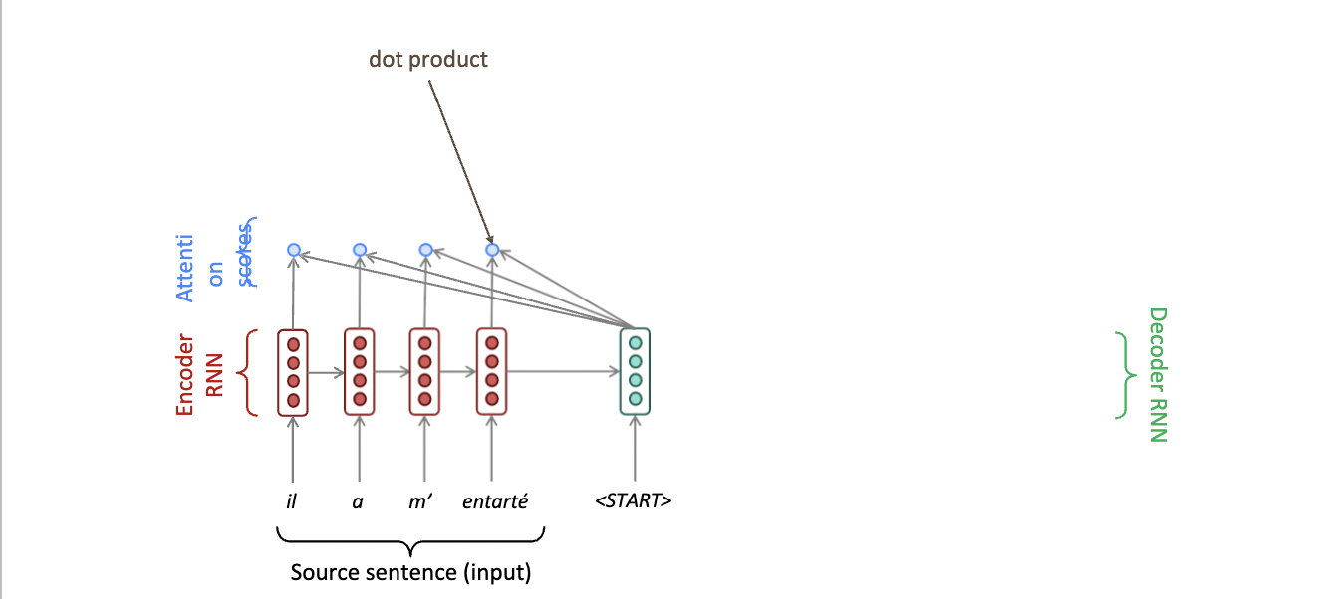
Seq to seq with Attention

Slide 6
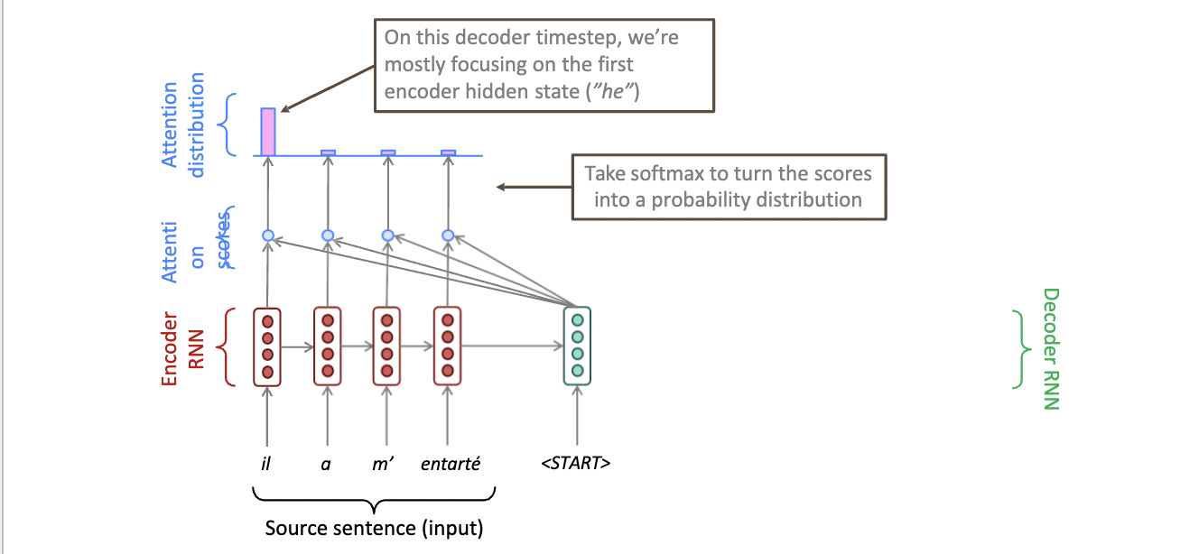
Seq to seq with Attention

Slide 7
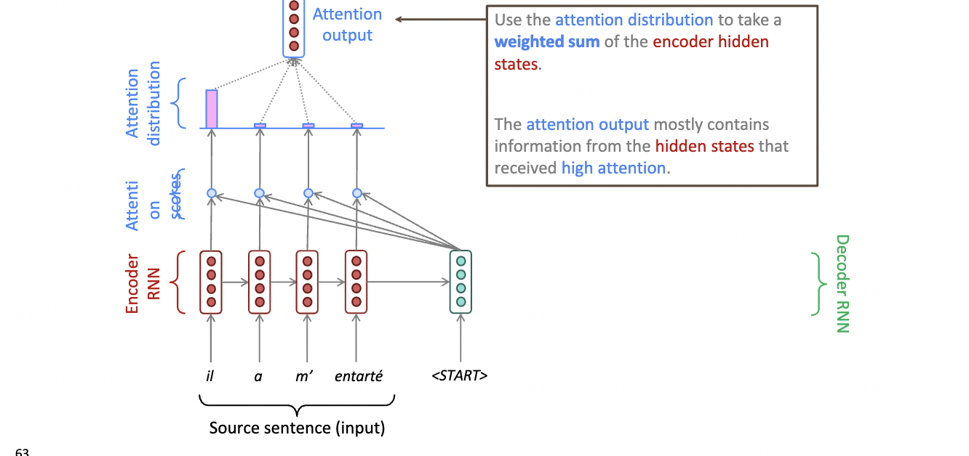
Seq to seq with Attention

Slide 8
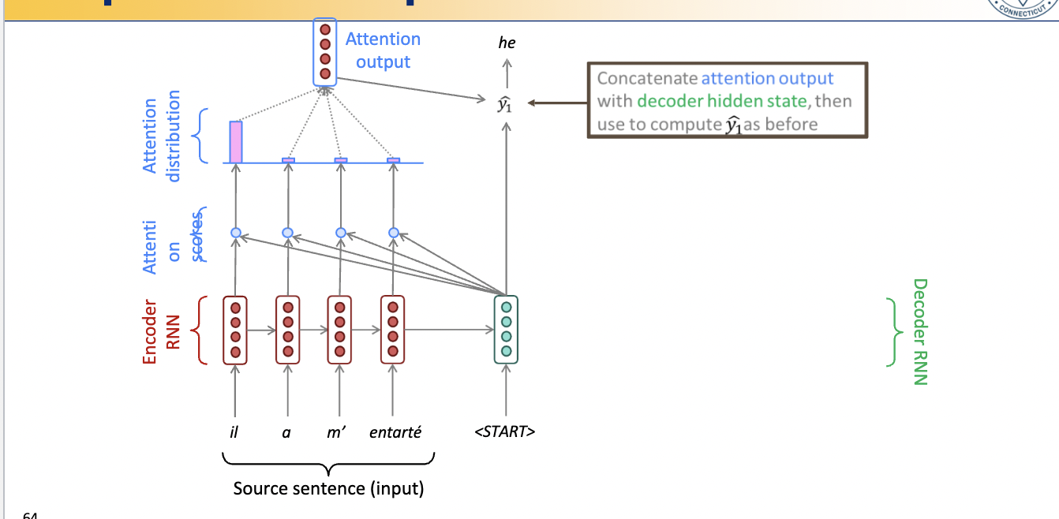
Seq to seq with Attention

Slide 9
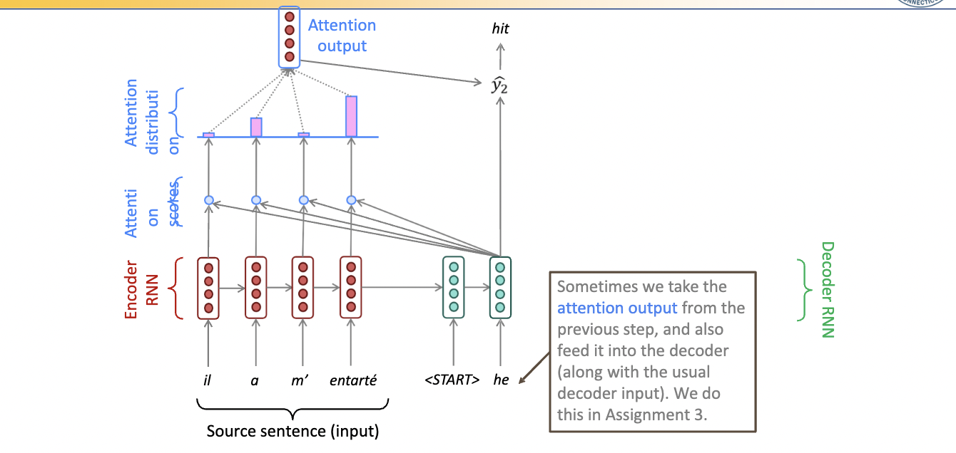
Seq to seq with Attention

Slide 10
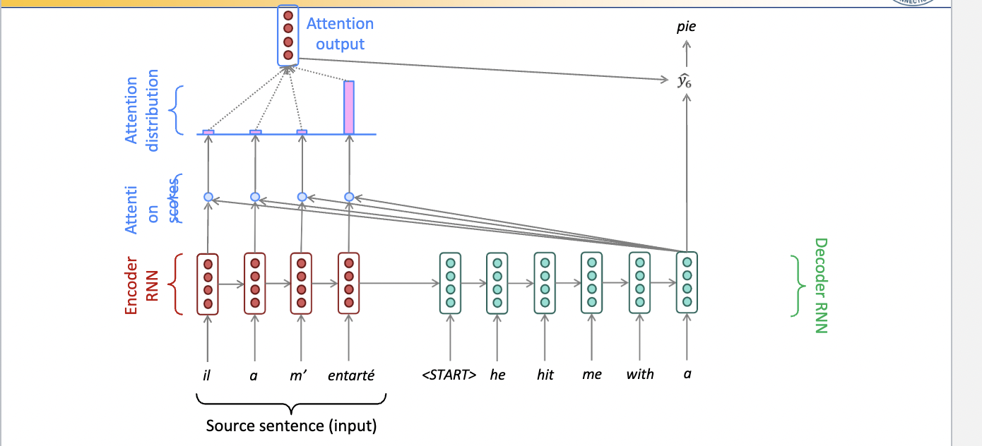
Seq to seq with Attention

Slide 11
Attention
Attention mechanisms in machine learning are used for focusing on specific parts of input data when making predictions or generating outputs.
Attention allows the model to consider the context and relevant information from the entire input sequence, assigning different weights to different elements based on their relevance to the current step in the output generation process.
Attention refers to a mechanism in which a model calculates attention scores between different parts of an input and another part of the input or external memory. For example, in machine translation, the attention mechanism calculates attention scores between the source sentence and the target sentence, allowing the model to weigh the importance of each part of the source sentence in the target translation.

Slide 12
Self- Attention
Self-attention is a specific type of attention mechanism where the input sequence is the same as the output sequence.
It is a mechanism that allows elements within the same sequence to attend to each other, considering the relationships and dependencies between elements within that sequence.
On the other hand, self-attention is a mechanism by which the model calculates attention scores between different parts of the input sequence without using external memory. Self-attention lets the model figure out how important each part of the series is, determine how the parts depend on each other and make predictions based on that.

Slide 13
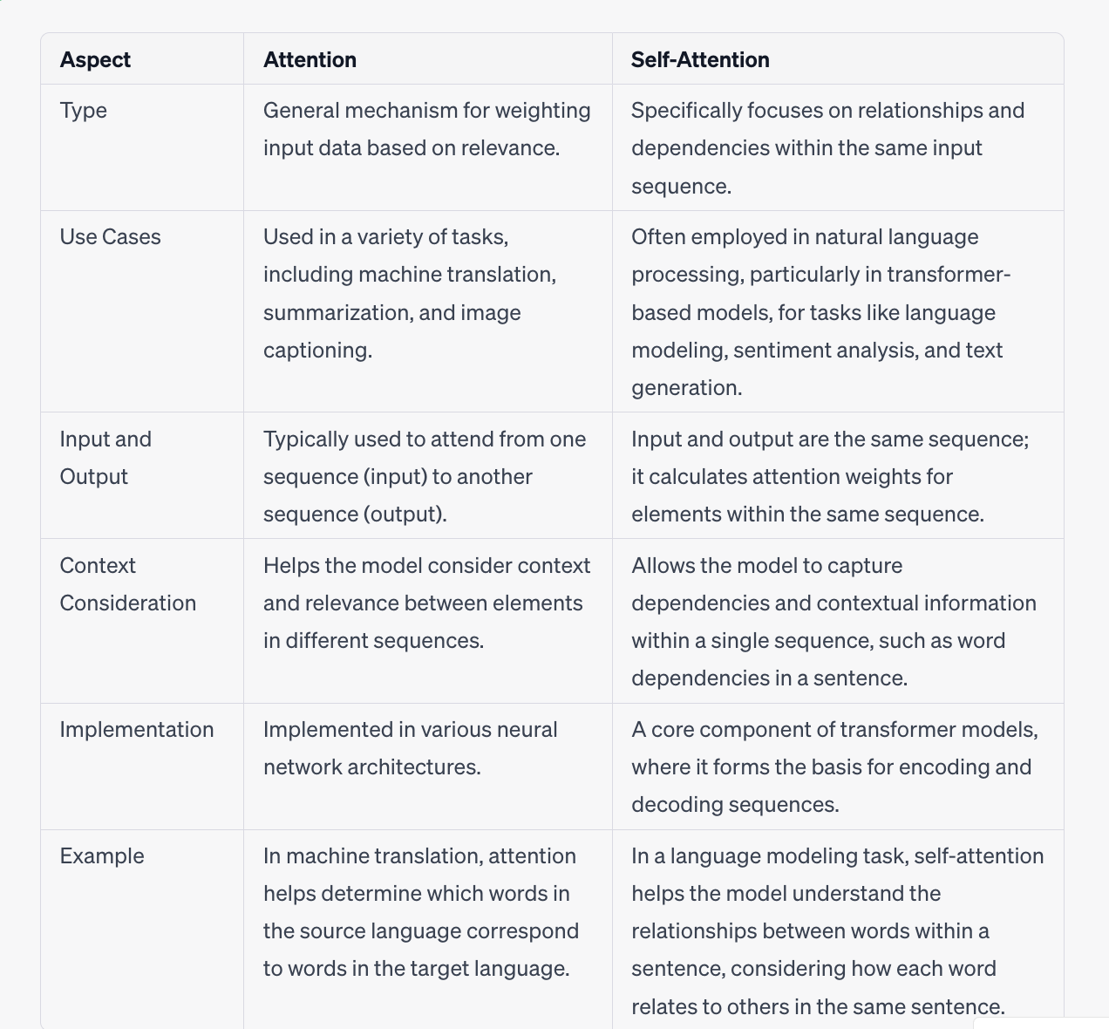

Slide 14
Steps in Self- Attention
Self-attention, also known as scaled dot-product attention, is a fundamental component in many modern natural language processing models, particularly in transformer architectures. It allows the model to capture dependencies and relationships within the same sequence of tokens (e.g., words in a sentence). Here are the steps involved in self-attention:
1. Input Sequence: The first step is to have an input sequence, which can be a sentence or any sequence of tokens. Each token is typically represented as a vector, and the entire sequence is a matrix where each row represents a token's vector.
2. Transform to Queries, Keys, and Values: In self-attention, the input sequence is transformed into three sets of vectors: queries, keys, and values. These transformations are usually linear projections learned during the model training. The purpose of this step is to give each token the role of a query, a key, and a value.

Slide 15
Continuation
3. Calculate Attention Scores: With the query, key, and value vectors ready, you calculate attention scores for each token in the sequence. This is done by taking the dot product of a query vector with all key vectors, which measures the similarity or relevance of one token to every other token. The dot products are then scaled and passed through a softmax function to obtain attention weights for each token.
4. Weighted Sum of Values: Using the attention scores obtained in the previous step, you compute a weighted sum of the value vectors. This weighted sum represents the attention-aware representation of each token, where tokens that are more relevant or similar to the others receive higher attention scores.
5. Multi-Head Attention (Optional): In many models, the self-attention mechanism is used in parallel for multiple "heads." This means that you repeat steps 2-4 with different sets of learned query, key, and value transformations. This allows the model to capture different types of relationships within the input sequence.

Slide 16
Continuation
6. Concatenate and Linear Projection (Optional): If multi-head attention is used, the results from different heads are typically concatenated and passed through another learned linear transformation to obtain the final self-attention output for each token.
7. Output: The self-attention mechanism produces a set of output vectors, one for each token in the input sequence. These output vectors capture the contextual information by considering the relationships and dependencies between tokens in the sequence.
Self-attention is a powerful mechanism that helps capture long-range dependencies and contextual information within sequences, making it highly effective for various NLP tasks, including language modeling, text classification, and machine translation. The output from self-attention is often used as input to subsequent layers in a neural network for further processing.

Slide 17
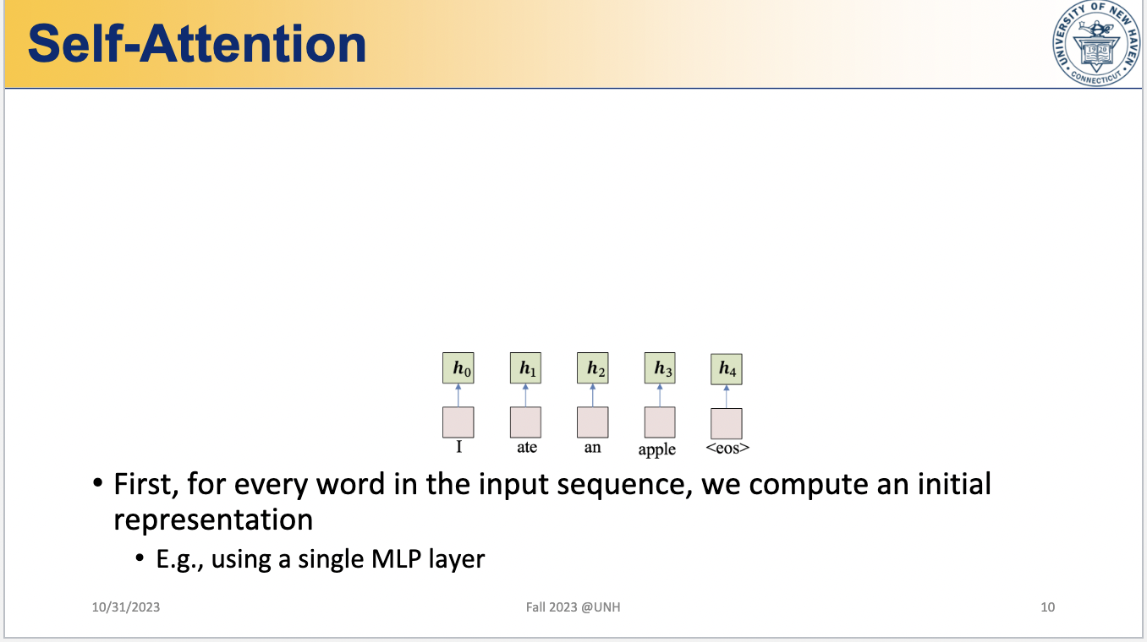

Slide 18
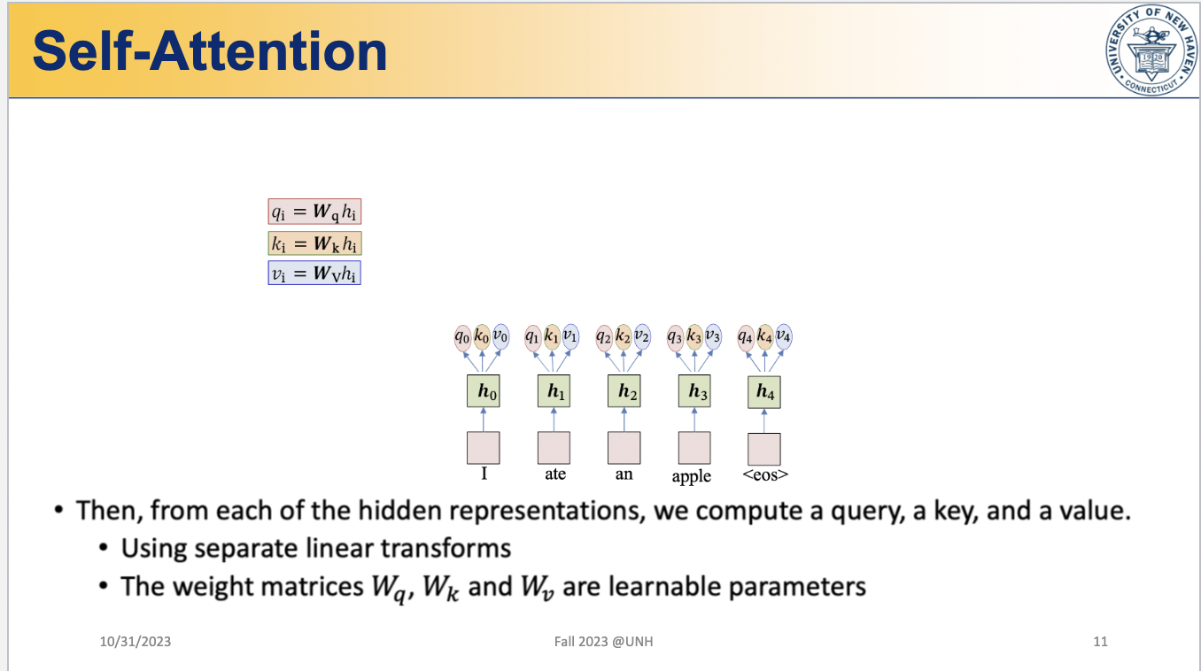

Slide 19
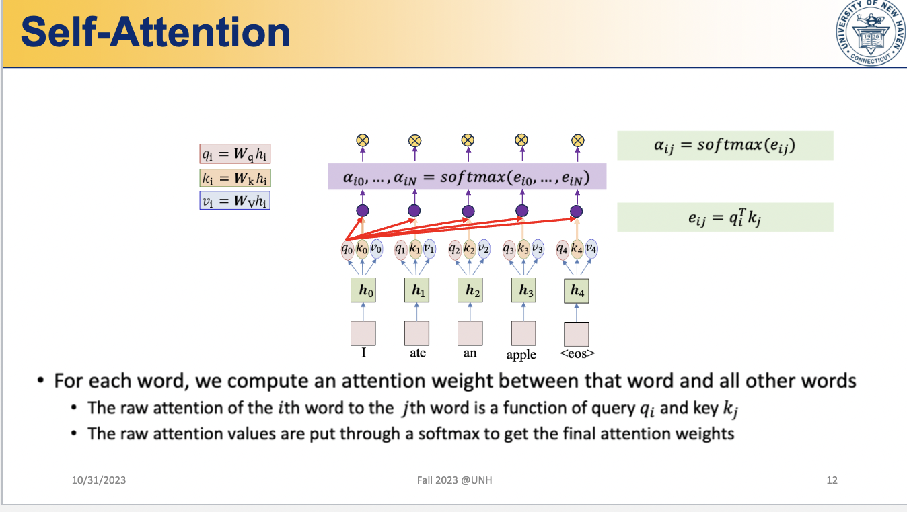

Slide 20
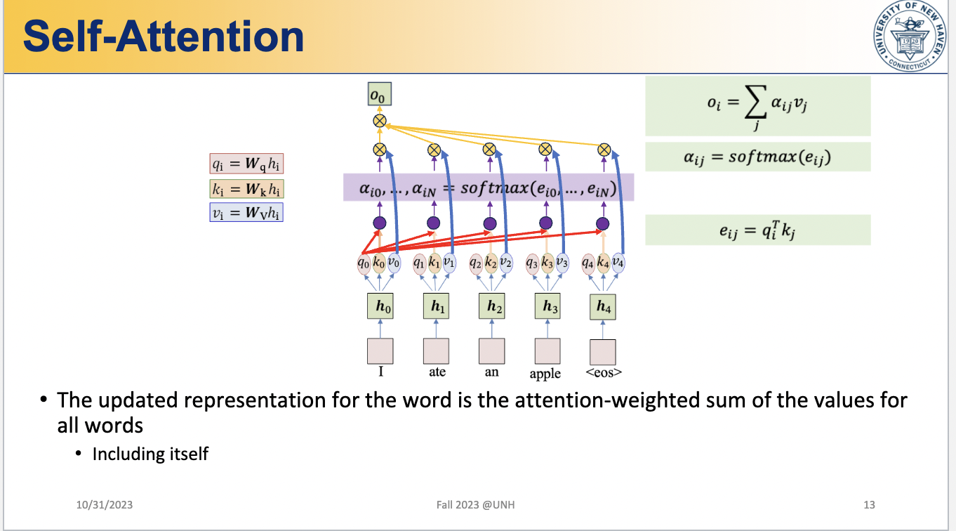

Slide 21
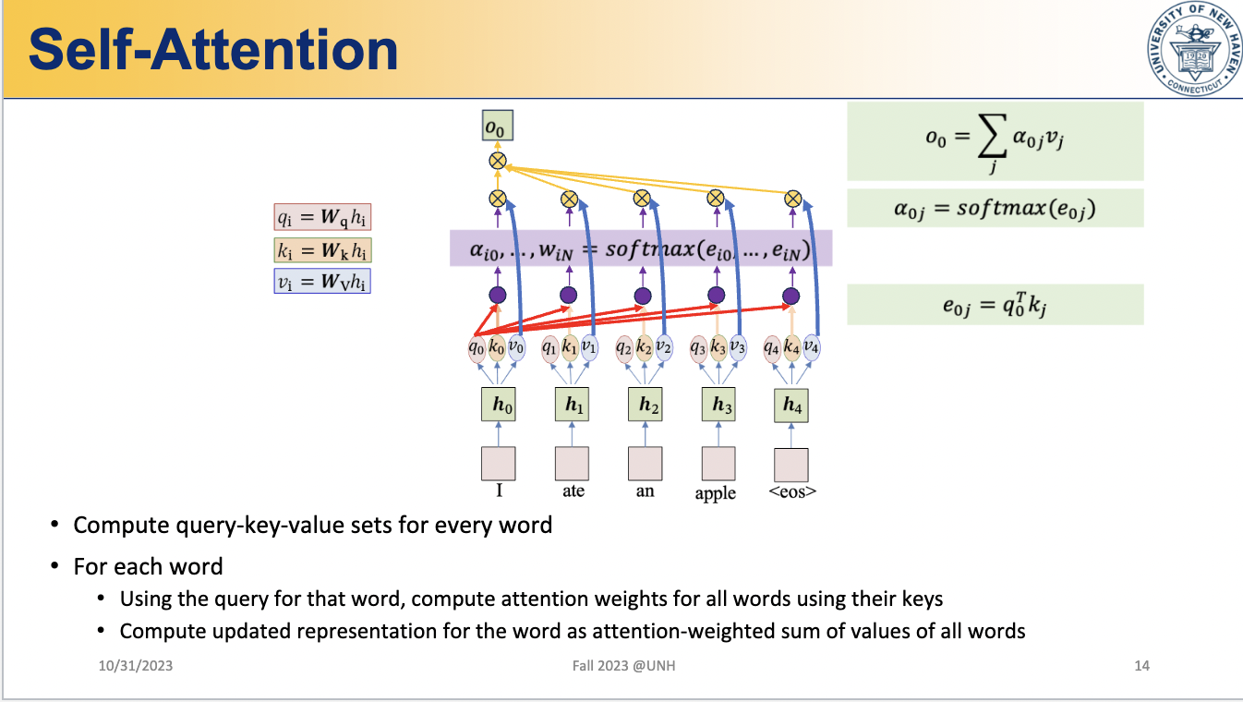

Slide 22
Why Self-attention is important
Self-attention has several benefits that make it important in machine learning and artificial intelligence:
Long-range dependencies: Self-attention allows the model to capture relationships between distant elements in a sequence, enabling it to understand complex patterns and dependencies.
Contextual understanding: By attending to different parts of the input sequence, self-attention helps the model understand the context and assign appropriate weights to each element based on its relevance.
Parallel computation: Self-attention can be computed in parallel for each element in the sequence, making it computationally efficient and scalable for large datasets.

Slide 23

Thank you.

